Slide 1


Analysis of Social Buzz’s Top 5 Popular Categories

Slide 2


Today's agenda
Project recap
Problem
The Analytics team
Process
Insights
Summary

Slide 3

Project Recap
Notes:
Social Buzz is a social media technology unicorn that need to adapt quickly to it’s growing global scale.
Accenture has been tasked with:
﻿﻿An audit of Social Buzz's big data practice
﻿﻿Recommendations for a successful IPO
﻿﻿Analysis to find Social Buzz's top 5 most popular categories of content
My task as the data analyst is to analyze Social Buzz dataset and find the top 5 most popular content categories and provide insights into how they can leverage this to make informed business decisions for their company.

Slide 4

Problem
Notes:
Over 10000 posts per day
36,500,000 pieces of content per year.
Problem: How does Social Buzz capitalize on this? I conducted an analysis to find Social Buzz’s top 5 most popular categories of content.

Slide 5



Juliet Ofoegbu (Data Analyst)
The Analytics team
Andrew Fleming (Chief Technical Architect)
Marcus Rompton (Senior Principle)

Slide 6
Process
1
Understanding the Project
2
Data Cleaning
3
Data Modelling
4
Data Analysis
5
Uncovering Insights

Slide 7

Insights

Slide 8
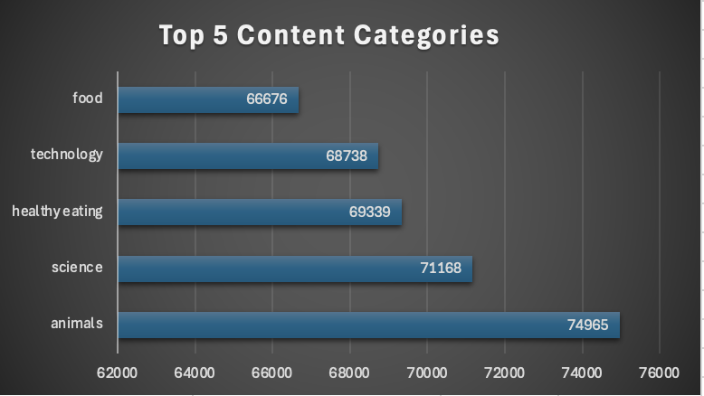

Slide 9
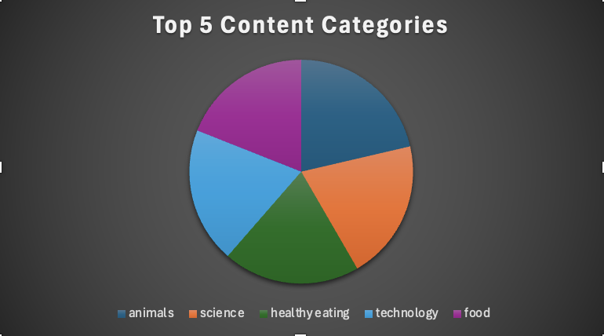

Slide 10

Other Insights:
1. There are 16 unique categories in the dataset. This was gotten by removing the duplicate values from the ‘Category’ column.
2. The month with the most posts is November 2021, with a total of 447 posts. I got this by extracting the month from the ‘DateTime’ column, counting the posts per month, and sorting it in descending order to get the top month. Might not be so accurate as not all the dates in the ‘DateTime’ column was in mm-dd-yyyy format for easy extraction.
3. I used the bar chart and pie chart to visualize the top 5 content categories as they’re the most appropriate chart type to visualize this particular insight.
Summary

Slide 11

Thank you!
ANY QUESTIONS?

